Slide 1
Eulerian Video Magnification
Revealing subtle changes in color and motion
Spencer yue

Slide 2
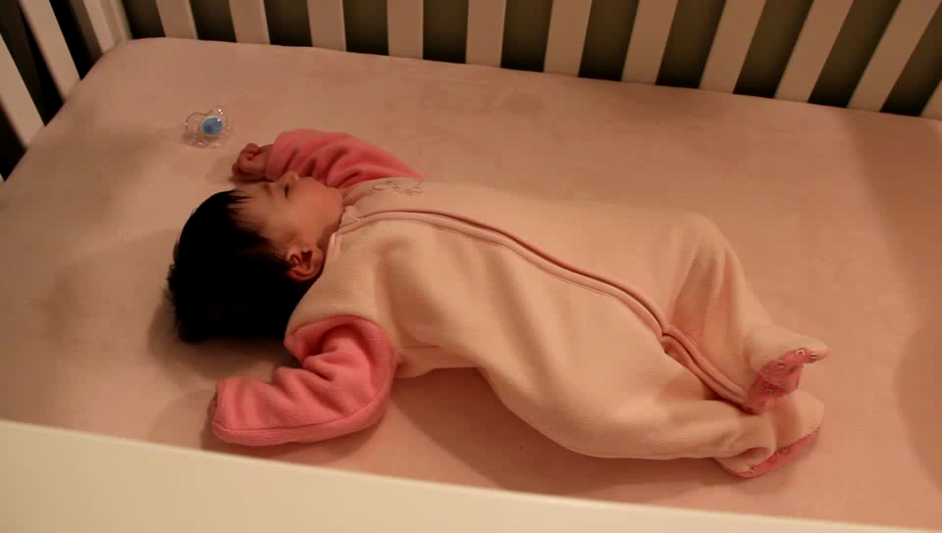
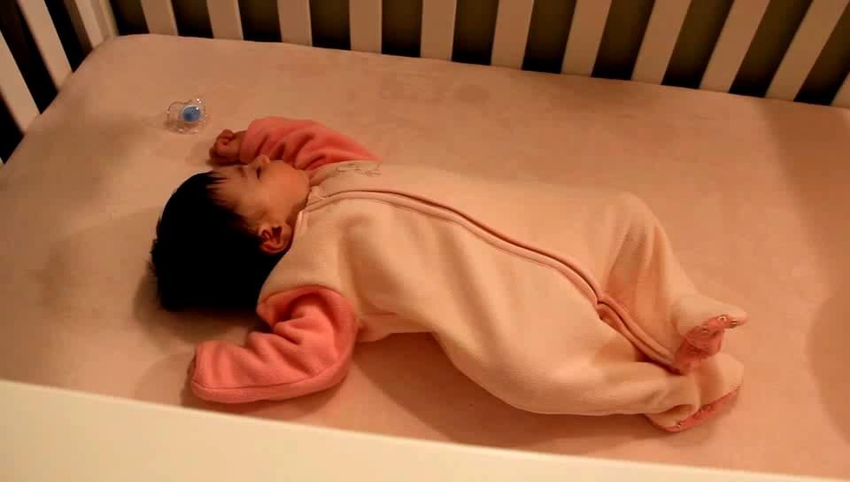
Goal

Slide 3
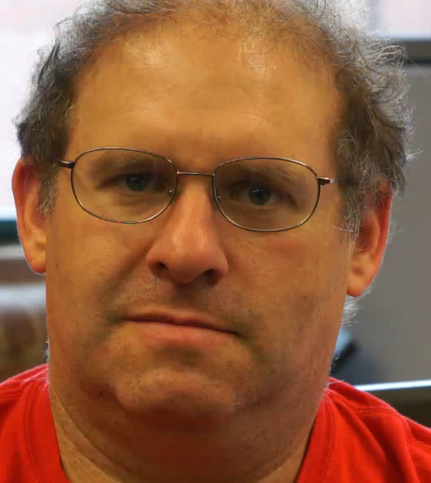
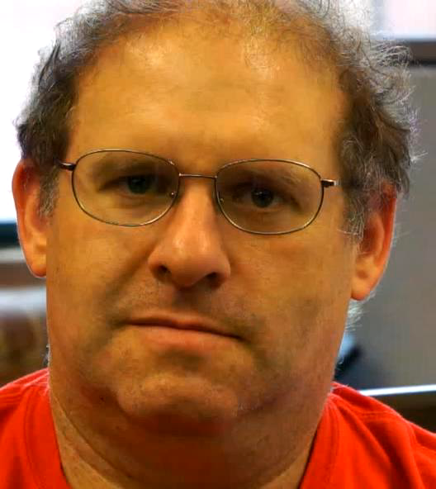
goal

Slide 4






Language breakdown
Javascript for UI controls and “glue”
C for algorithm
Compiled to WebAssembly (can run in browser)
Python web server for local testing
HTML and CSS for front end

Slide 5

Key Tool: Web Assembly
New Web standard: run assembly-like code in browser at near native speeds
Uses a single large Javascript TypedArray to represent memory (program’s heap)
Compile to Web Assembly from any LLVM supported language (e.g. C, C++)
Emscripten (hook-on to LLVM) does the translation
Real time algorithm

Slide 6
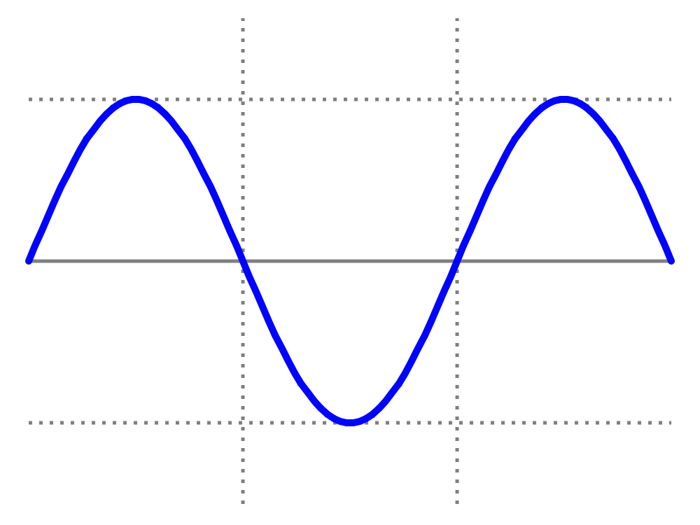
ALGORITHM SUMMARY
IDEA: Increase the magnitude of translations of a cosine wave over time (i.e. increase the phase shift)

Slide 7
ALGORITHM SUMMARY
KEY: Small-angle approximation, cosine angle-addition formula, and first-order Taylor approximation imply adding +θ is close to phase-shifting by +θ times the first derivative.
θ
First derivative

Slide 8
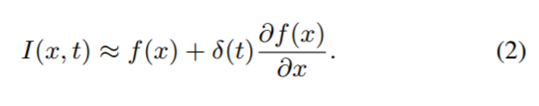
Algorithm summary
LAST PIECE: band-pass filtered signal approximates the first derivative
DC is filtered out
STRATEGY:
1. Spatially separate each frame into multiple frames of different frequency content.
2. Band-pass filter each pixel in a frame across time.
3. Multiply the band-passed pixels (“first derivative”) by amplification and add back to original frames.

Slide 9
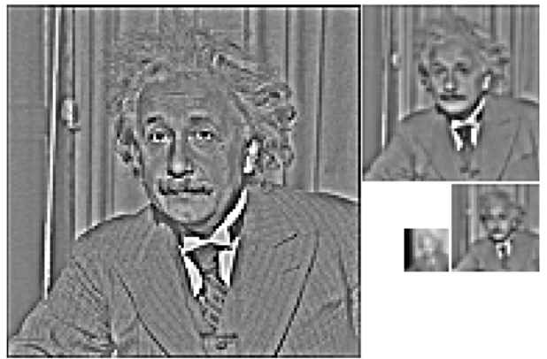
Spatial Filter: Laplacian Pyramid
Algorithm:
(1) Original image A_{i}
(2) Blur to get B
(3) Downsample to get C
(4) (A_{i} - C) → next A_{i}
Difference of Gaussians approximates Laplacian of Gaussians: “Laplacian Pyramid”
Reconstruction:
Blur and upsample A_{i} and add to A_{i+1} until get A₀ back.

Slide 10
TIME FILTER: IIR and IDEAL
Difference of Exponential IIR Filters gives simple band-pass filter
Update formula: y[n] = decay * y[n-1] + (1 - decay) * x[n]
For motion amplification
DCT ideal filter
Keep 2 seconds of input (~60 frames)
For color amplification

Slide 11
https://spenceryue.github.io/videomag/

